Slide 1
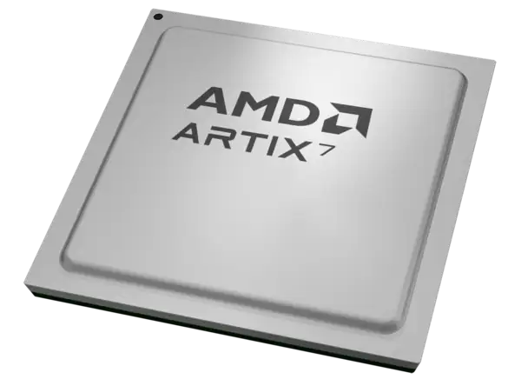
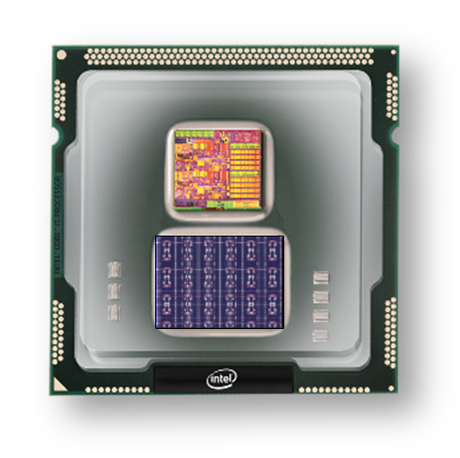
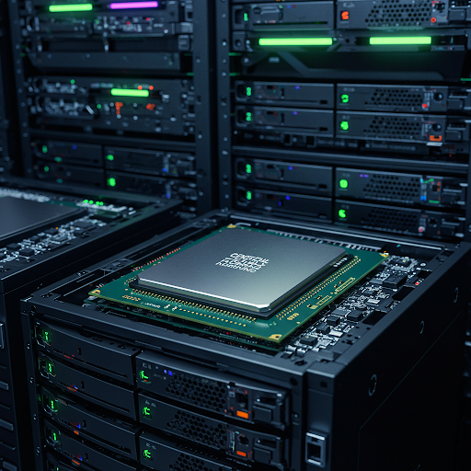
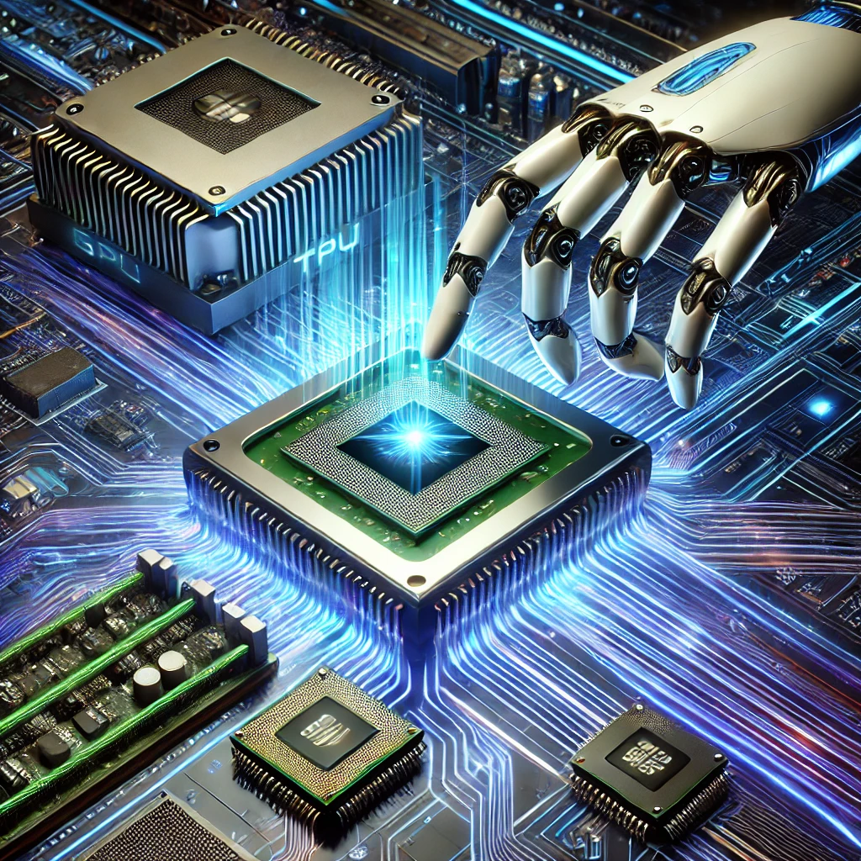
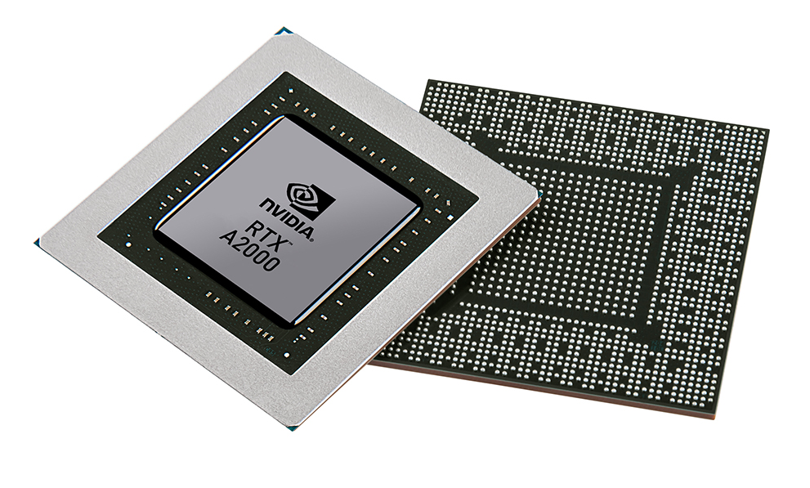


Christof Teuscher
ECE 410/510: Hardware for AI and ML
Hardware for AI and ML Overview + Co-design
Portland State University
Department of Electrical and Computer Engineering (ECE)
www.teuscher-lab.com
teuscher@pdx.edu

Slide 2
What is a computer?
What’s the job of a computer architect / chip designer?

Slide 3
What is computation? (1)
Computation
Mapping
Transformation
Function O_{t+1}=f(I_{t})
Inputs I
Outputs O
…
…
How can we “realize” this mapping?

Slide 4
What is computation? (2)
I₁ | … | I_{N} | O₁ | … | O_{M}
0 | … | 1 | 1 | … | 0
1 | … | 0 | 0 | … | 0
…
Inputs I
Outputs O
…
…
Look-up table
Simple, fast

Slide 5
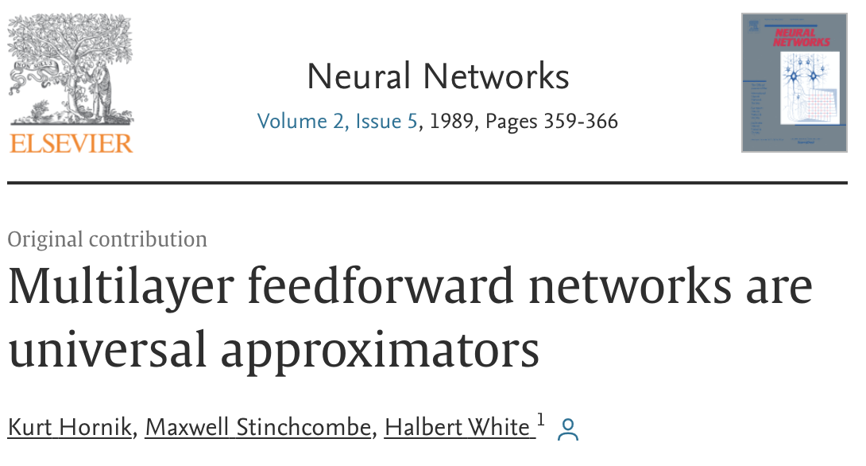
What is computation? (3)
Feedforward
No memory/state
Generalization
Weights
Inputs I
…
Outputs O
…
…
Output nodes
Hidden nodes
Various training algorithms
Guaranteed convergence
Input nodes
Neural network
Universal function approximator
(Hornik, Stinchcombe, White, 1989, https://doi.org/10.1016/0893-6080(89)90020-8)

Slide 6
What is computation? (4)
Inputs I
Outputs O
…
…
Feedback
Dynamical system
Memory is needed in a lot of cases
Temporal signal processing (audio, video)
Timeseries prediction
Control tasks

Slide 7
What is computation? (5)
Weights
Recurrent connections
Inputs I
…
Outputs O
…
…
…
Output nodes
Hidden nodes
Dynamical system
Integration over time
Input nodes
Recurrent neural networks (RNN)
Training is challenging, various algorithms exist (backpropagation through time), convergence not
guaranteed, many weights, slow learning. RNNs are also universal function approximators
(Schaefer & Zimmerman, 2007, https://doi.org/10.1142/S0129065707001111)

Slide 8
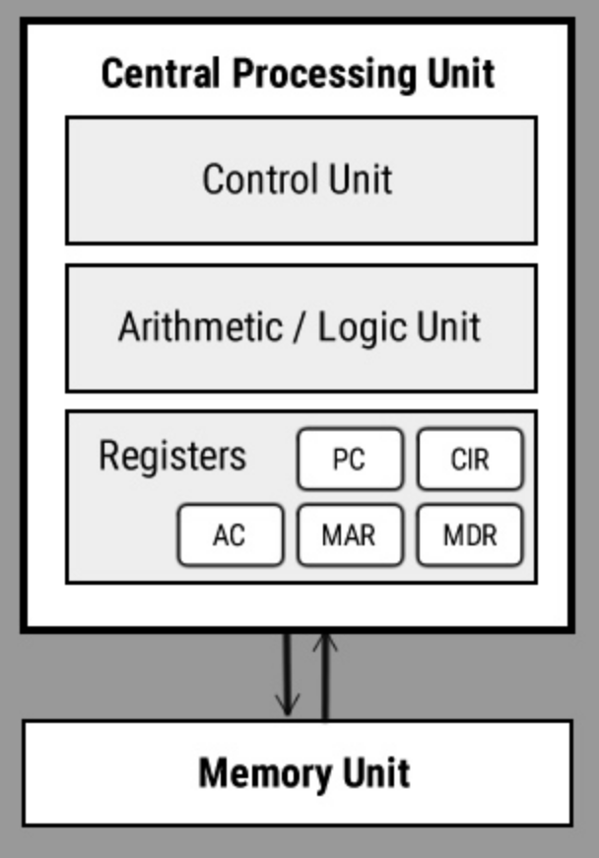
What is computation? (6)
Inputs I
Outputs O
…
…
…

Slide 9
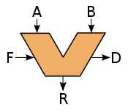
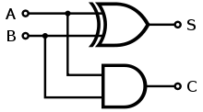
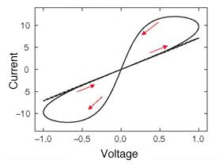
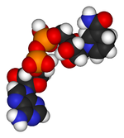

Intrinsic vs designed computation (2)
Desired computation
Computing architecture
How to obtain a desired computation?
Intrinsic dynamics
Device network

Slide 10
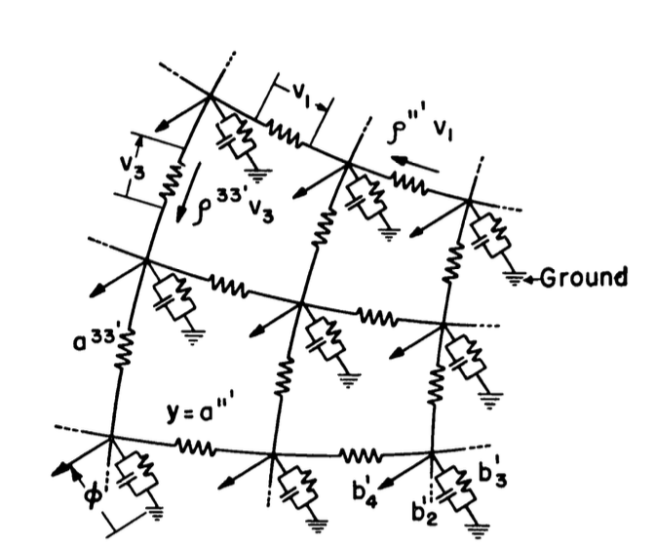
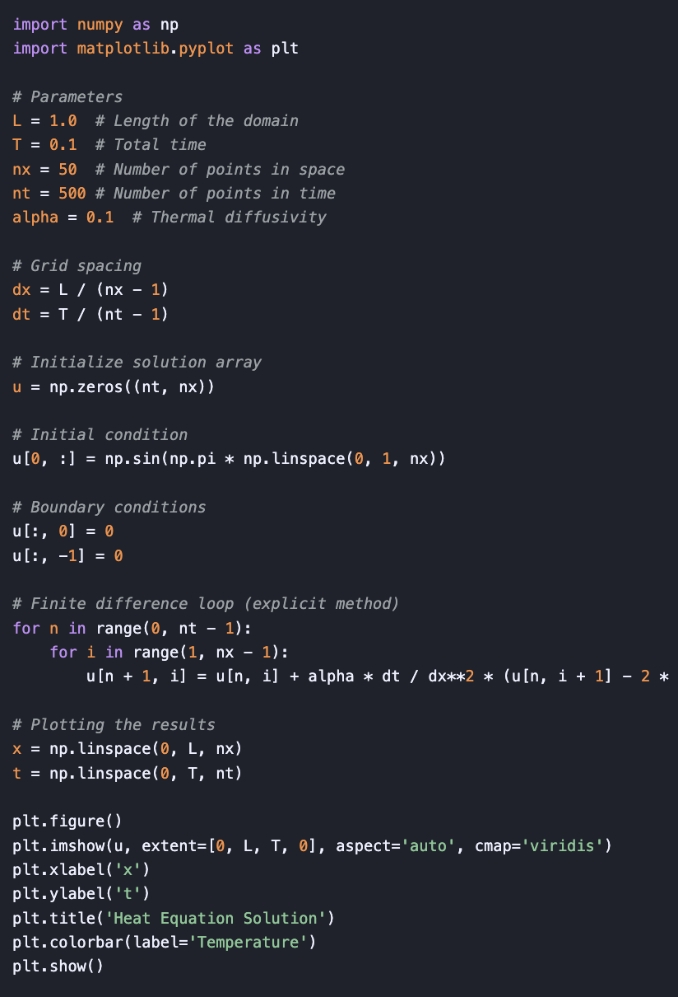

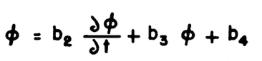
Intrinsic vs designed computation (3)
vs
Kron, Gabriel. "Electric circuit models of partial differential equations." Electrical Engineering 67, no. 7 (1948): 672-684.

Slide 11
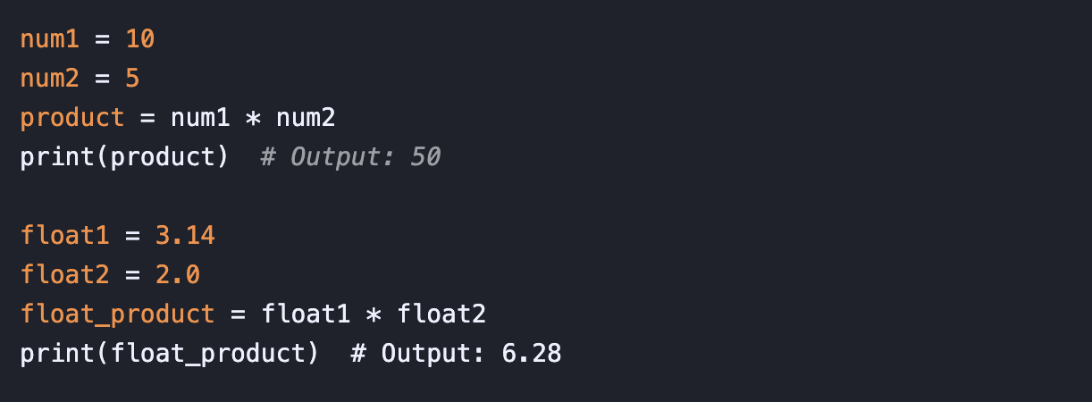
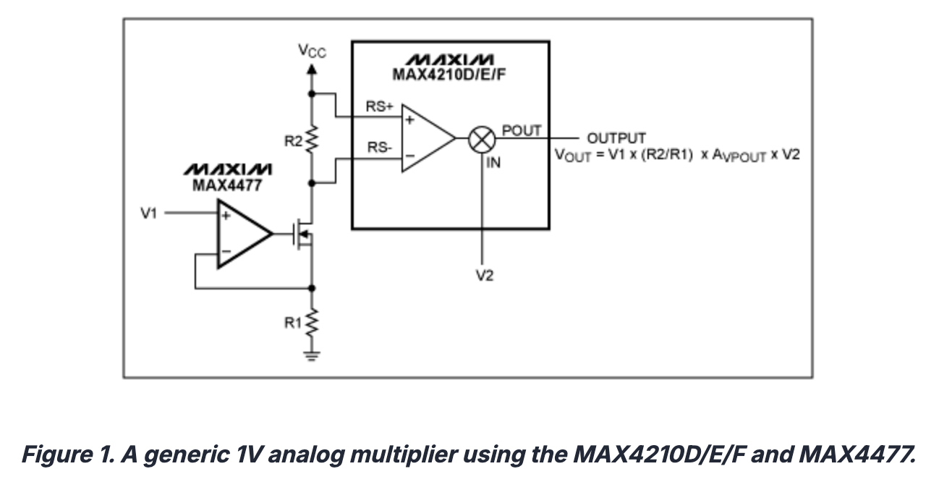
Intrinsic vs designed computation (4)
vs
https://www.analog.com/en/resources/design-notes/using-a-generic-0-to-1v-analog-multiplier-to-ensure-accurate-power-management.html

Slide 12
What are the design trade-offs?

Slide 13
What are the design trade-offs?
Performance
Flexibility (general purpose vs application-specific)
Energy efficiency
Power density (avoid burning chip, cost of cooling technology)
Design complexity
Design cost
Scalability
Shrinking design schedules (time-to-market)

Slide 14
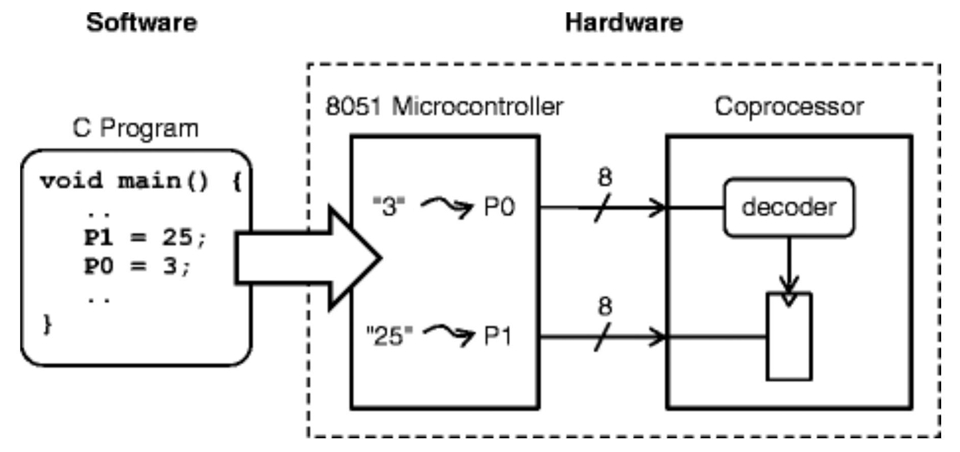
What is (HW/SW) co-design?
The practice of taking the best from software design and the best from hardware design to solve design problems.
HW/SW co-design deals with HW/SW interfaces.
HW/SW co-design is the design of cooperating HW and SW components in a single design effort.
Why design new HW if there is already one available to do the job? E.g., a RISC processor?
From a flexibility and design effort perspective, as much as possible should be in software. [Easy, flexible, available libraries, etc.]
Schaumont, 2013

Slide 15
Why is HW/SW co-design important for AI/ML
Performance optimization: Traditional hardware design assumes fixed software, while traditional software design assumes fixed hardware. Co-design breaks this barrier by simultaneously optimizing both, leading to significant performance improvements for AI workloads.
Specialized acceleration: AI algorithms have unique computation patterns (like matrix multiplications and convolutions) that benefit from custom hardware accelerators tailored to these specific operations.
Memory bottlenecks: AI models face severe memory bandwidth constraints. Co-designing hardware memory hierarchies with software that efficiently schedules operations can minimize data movement and maximize throughput.
Energy efficiency: By tailoring hardware precisely to the needs of ML workloads and optimizing software to take advantage of hardware capabilities, co-design dramatically reduces power consumption, which is critical for both data centers and edge devices.

Slide 16
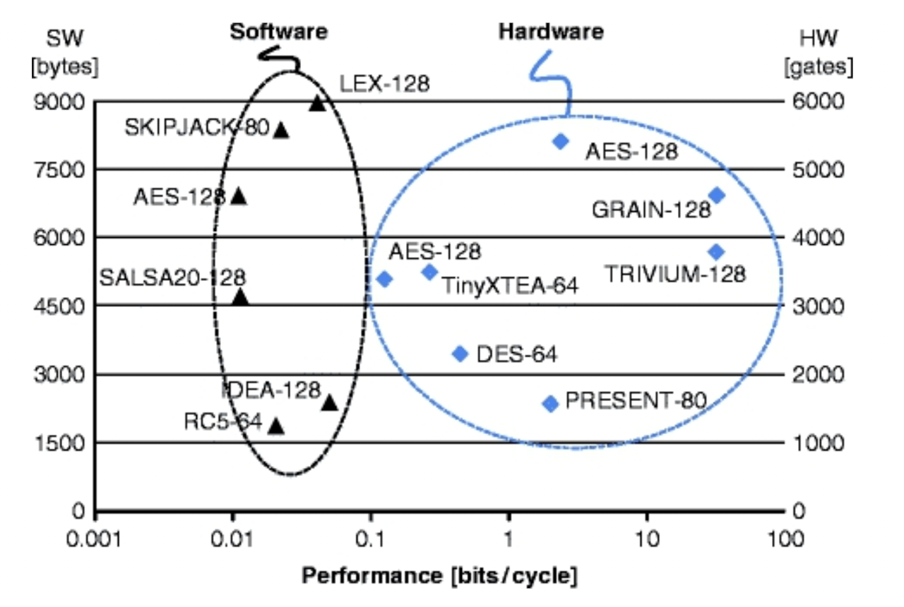
Cryptography on small embedded platforms
What do we learn here?
Schaumont, 2013

Slide 17
Cryptography on small embedded platforms
Hardware crypto-architectures have, on the average, a higher relative performance compared to embedded processors.
Schaumont, 2013

Slide 18
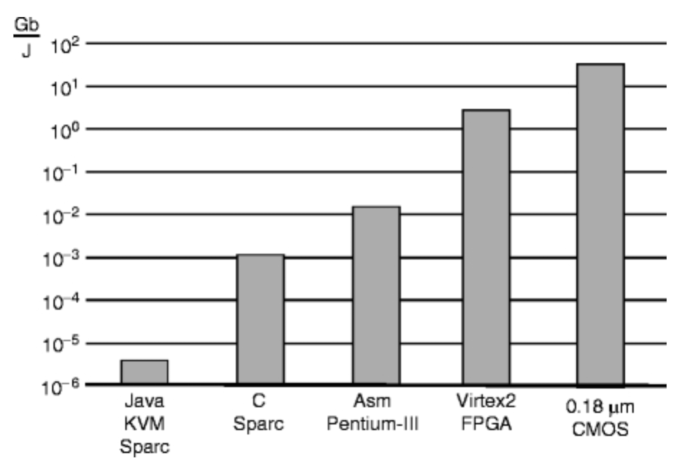
Cryptography on small embedded platforms
AES for different target platforms
What do we learn here?
Schaumont, 2013

Slide 19
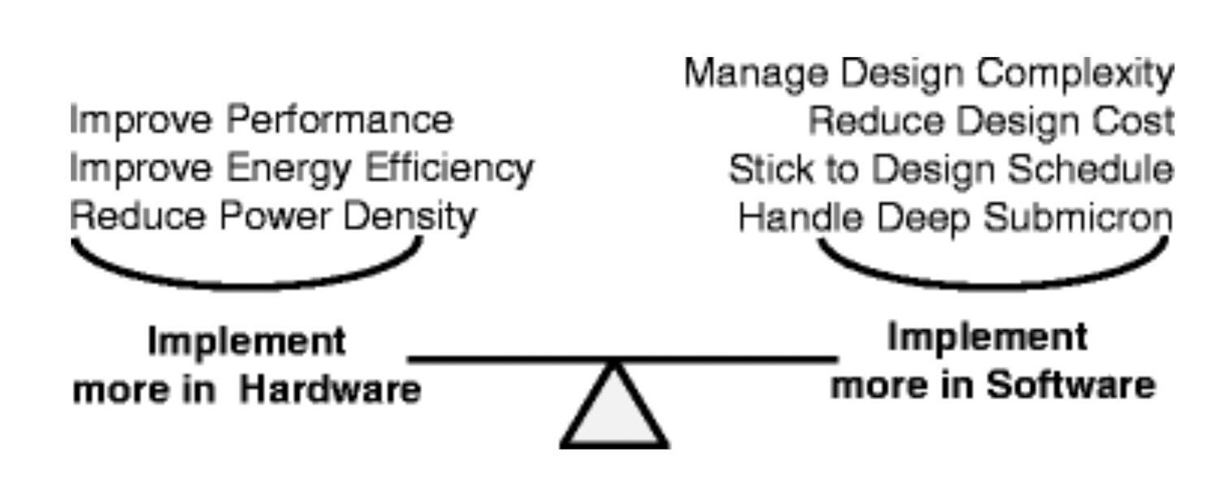
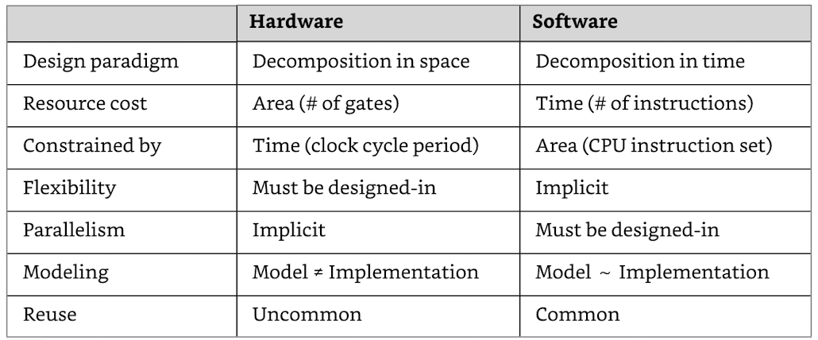
Driving factors in HW/SW co-design + dualism
Schaumont, 2013

Slide 20
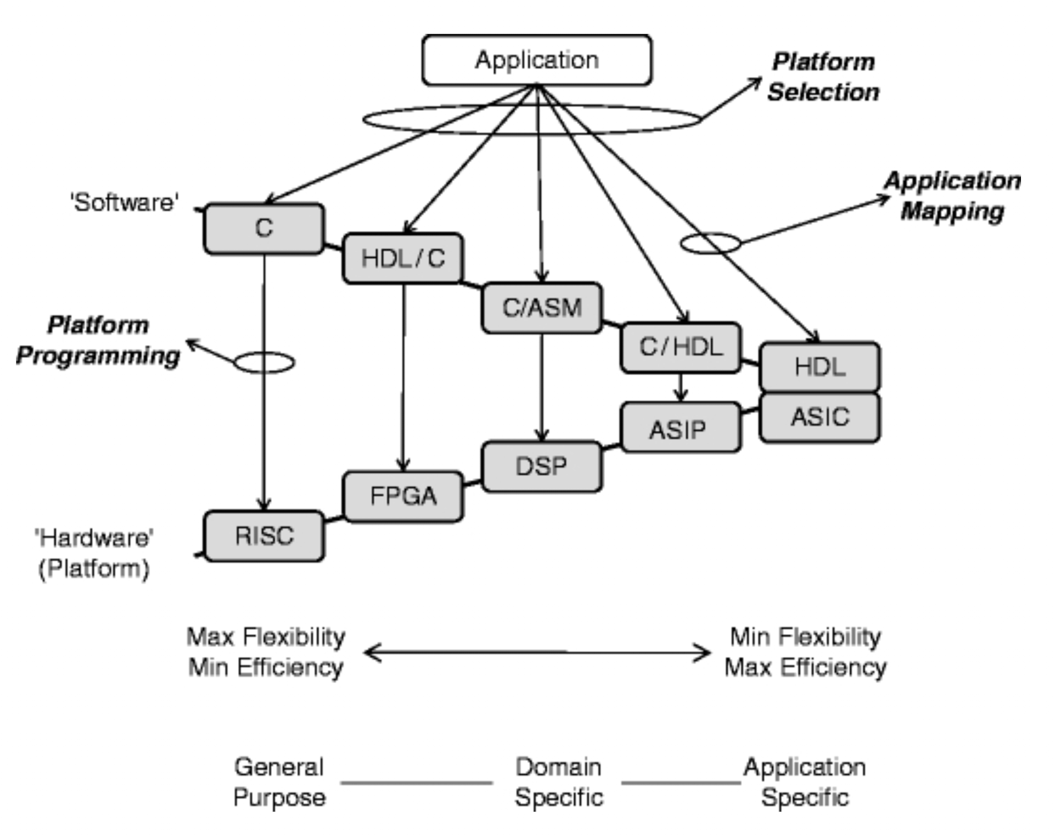
The HW/SW co-design space
ASIP = Application Specific Instruction Processor
Schaumont, 2013

Slide 21
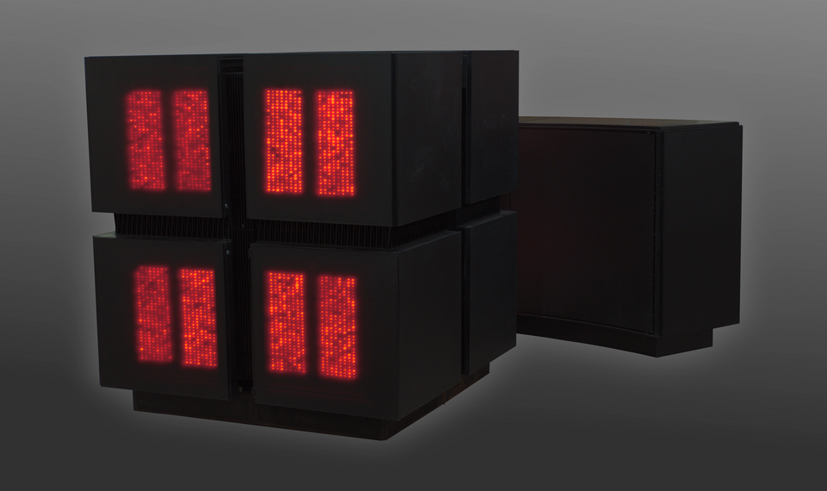
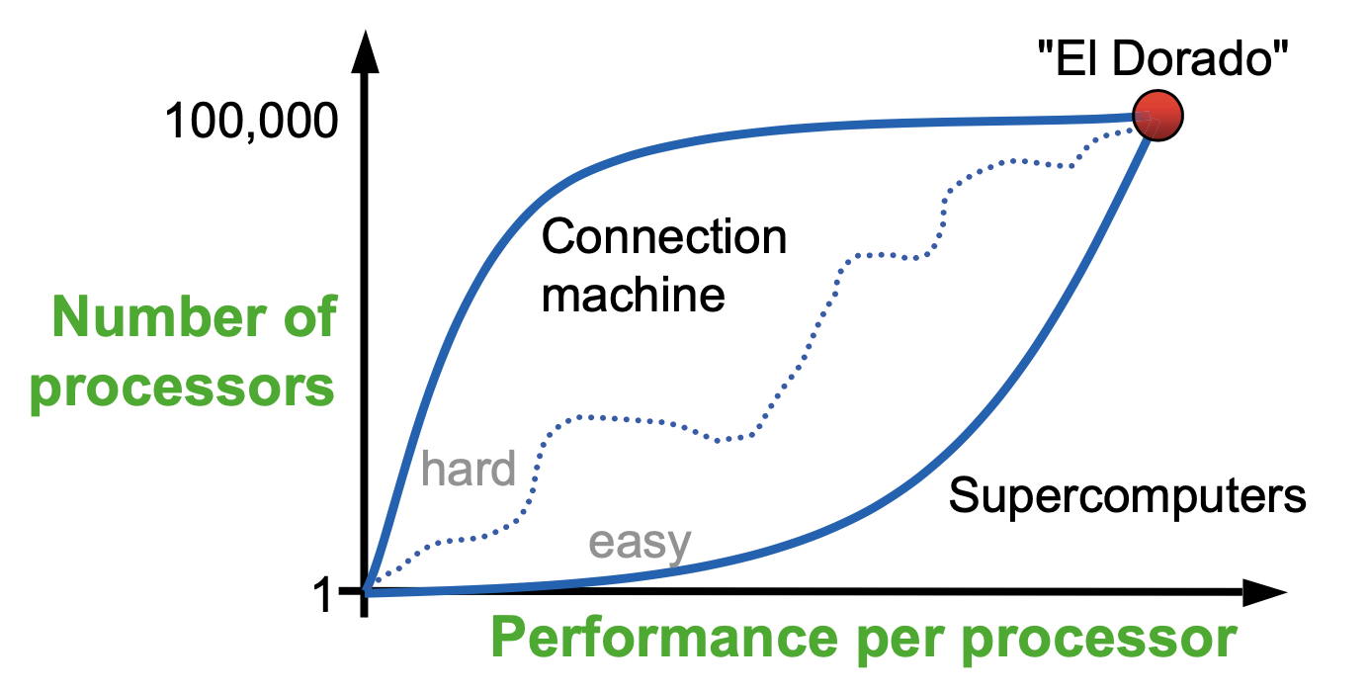
The goals and drivers have changed
Avogadro-scale computing
Large number
CM 1 & 2: Up to 65,536 1-bit processors
The number of units in one mole of any substance is called Avogadro's number or Avogadro's constant.
6.02×10²³

Slide 22
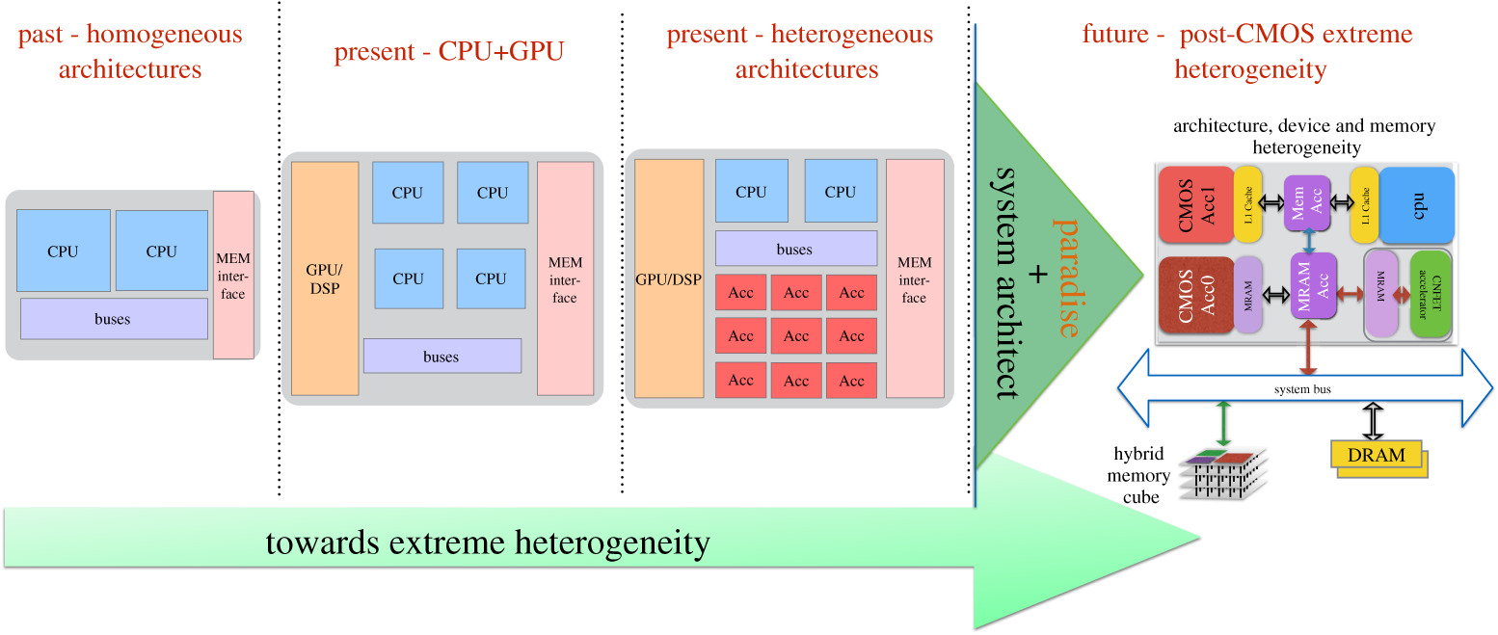
The goals and drivers have changed
https://royalsocietypublishing.org/doi/10.1098/rsta.2019.0061

Slide 23
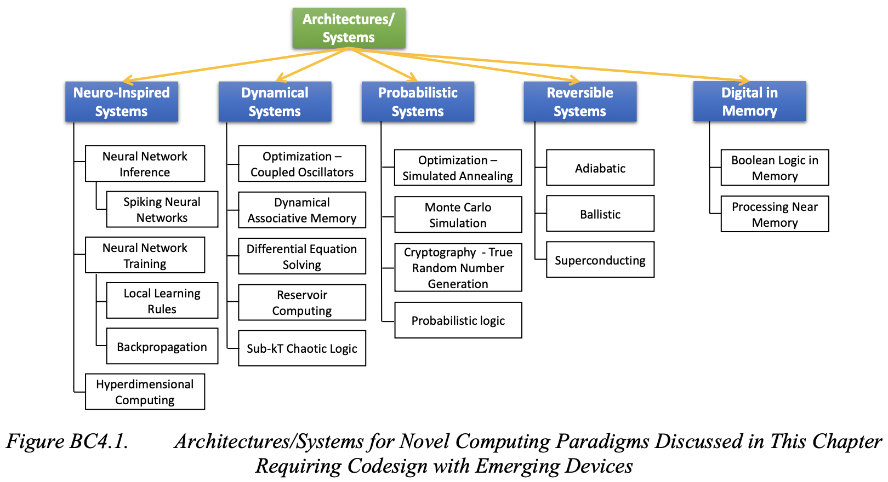
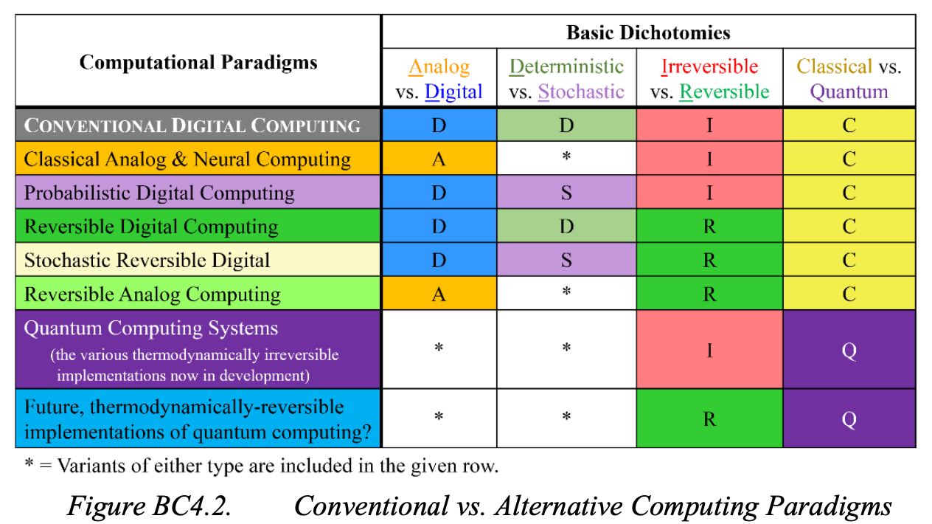
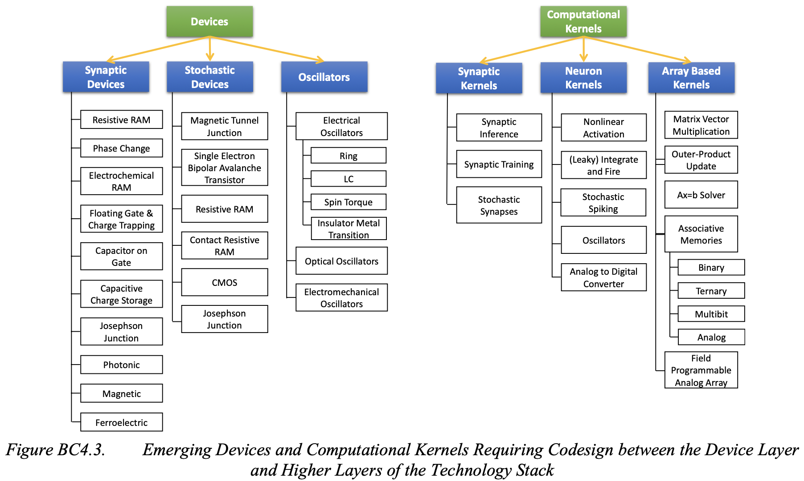
Deep co-design across the entire stack

Slide 24

Paper discussion
What did you learn?

Slide 25
Paper discussion (1)
The difference between these papers shows how the field of co-design has evolved from general principles to specialized approaches for complex AI systems over nearly three decades.
LLMs face unique challenges compared to traditional deep learning systems, requiring extensive computational resources, high energy consumption, and complex software optimizations.
LLMs differ from CNNs in their memory requirements and processing patterns, requiring unique co-design methodologies.

Slide 26
Paper discussion (2)
Co-design is about a systems perspective: meeting system-level objectives.
Co-design is the key to designing efficient systems.
Designing HW is increasingly like designing SW.
Flexibility vs performance trade-off.
E.g., reconfigurability increases usability, but does not increase performance.
Co-design tools: modeling, validation, implementation.
Identify critical segments of SW and run them on special HW.
LLMs require unique optimization strategies.
GPT-3: 175 billion parameters, 350GB of GPU memory just for parameters
GPUs are the cornerstone of modern deep learning infrastructure.

Slide 27
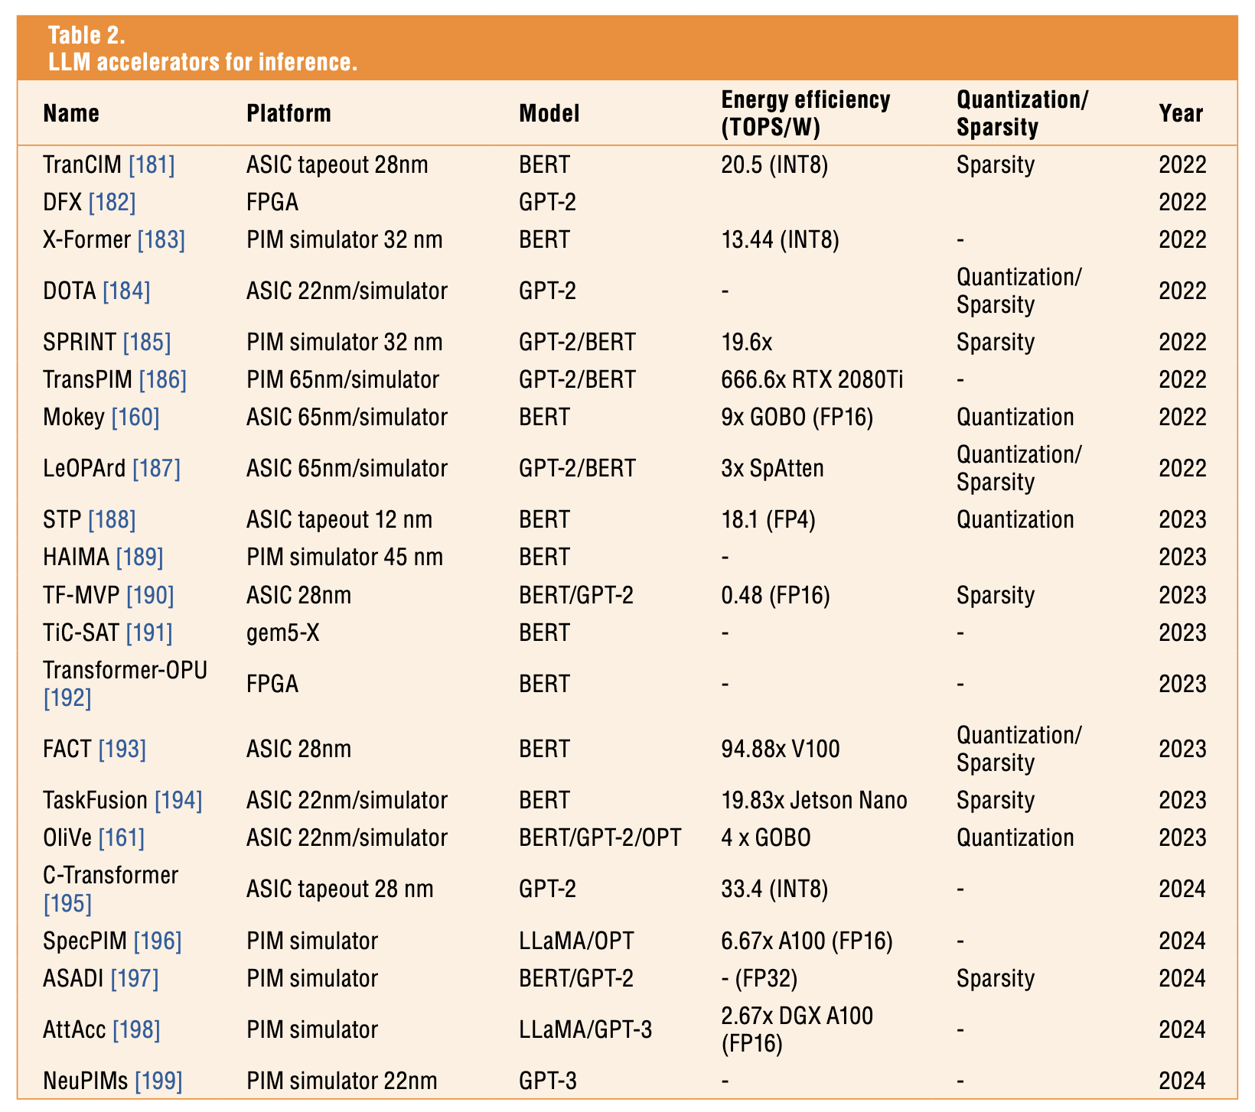
Paper discussion (3)
Guo et al., 2025

Slide 28
What is Artificial Intelligence (AI)?
What is Machine Learning (ML)?

Slide 29
AI vs ML
Machine Learning (ML) is one technique used to achieve Artificial Intelligence (AI).
All ML is AI, but not all AI is ML.
AI is the destination (e.g., intelligent machines), while ML is one path to get there (learning from data).
Artificial Intelligence (AI): Broader concept encompassing machines that can perform tasks requiring human intelligence. Ultimate goal: Artificial General Intelligence (AGI)
Machine Learning (ML): Subset of AI focused specifically on algorithms that improve through experience. Example: neural networks

Slide 30
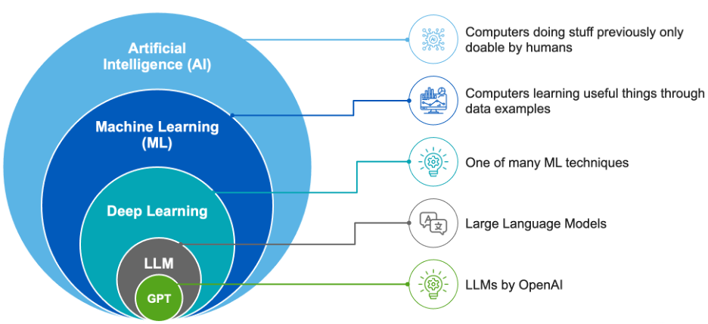
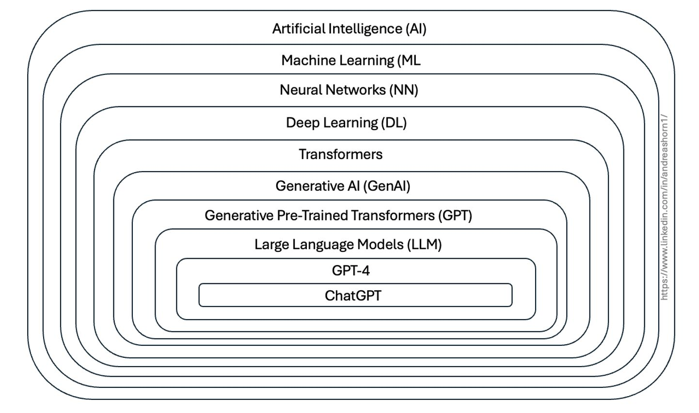
AI vs ML
Source: Tignis

Slide 31
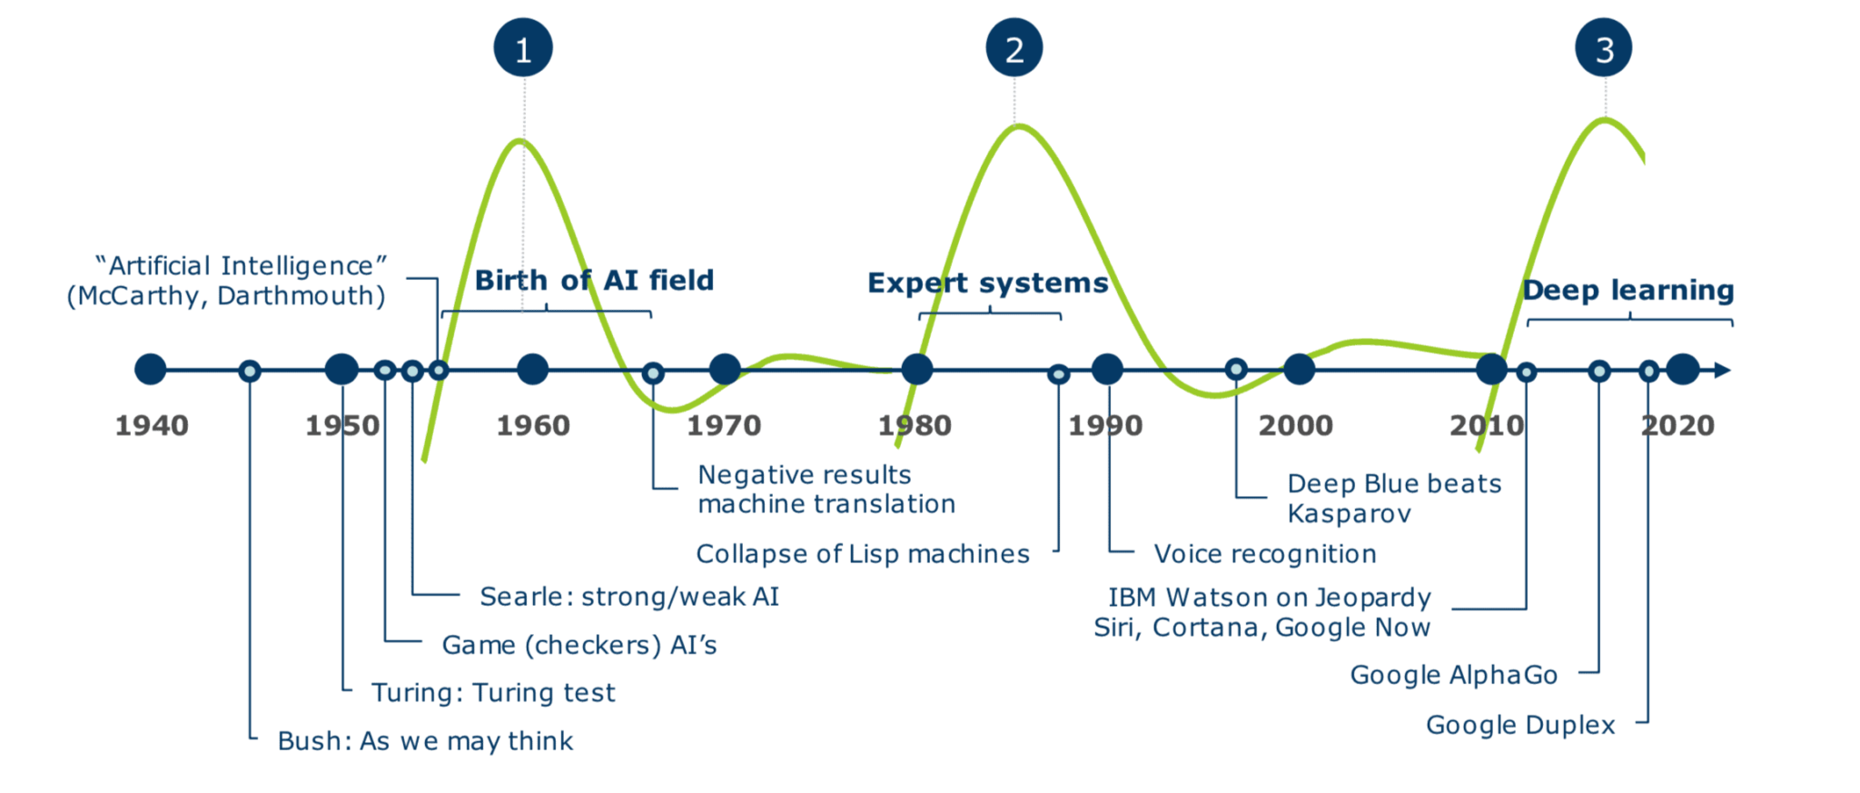
A very brief history of AI
Strong AI = AGI = Artificial General Intelligence

Slide 32
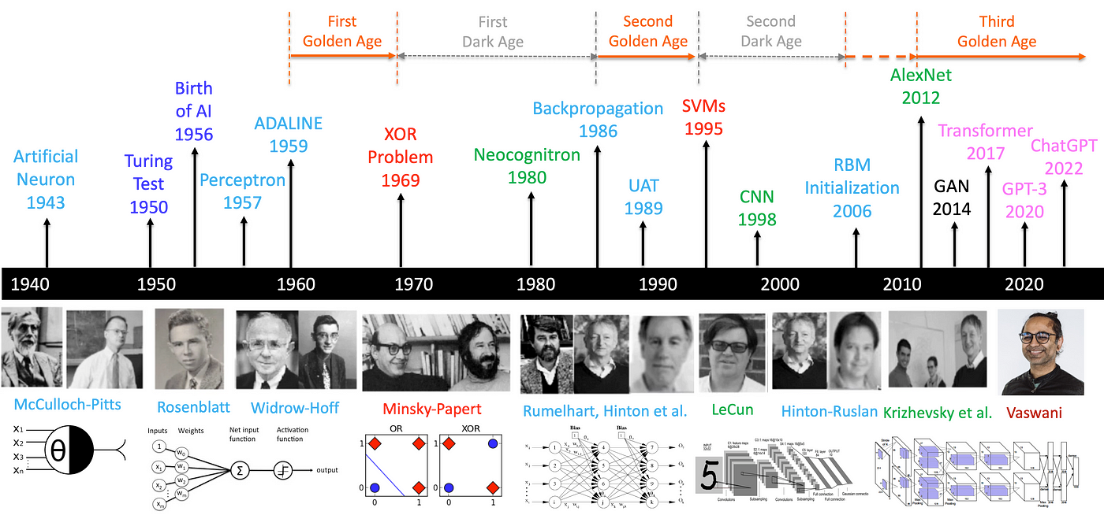
A very brief history of AI with deep learning
https://medium.com/@lmpo/a-brief-history-of-ai-with-deep-learning-26f7948bc87b

Slide 33
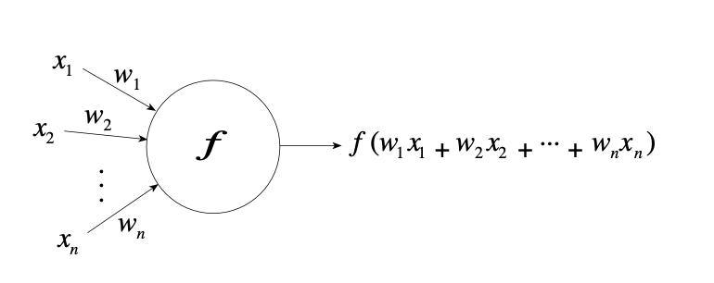
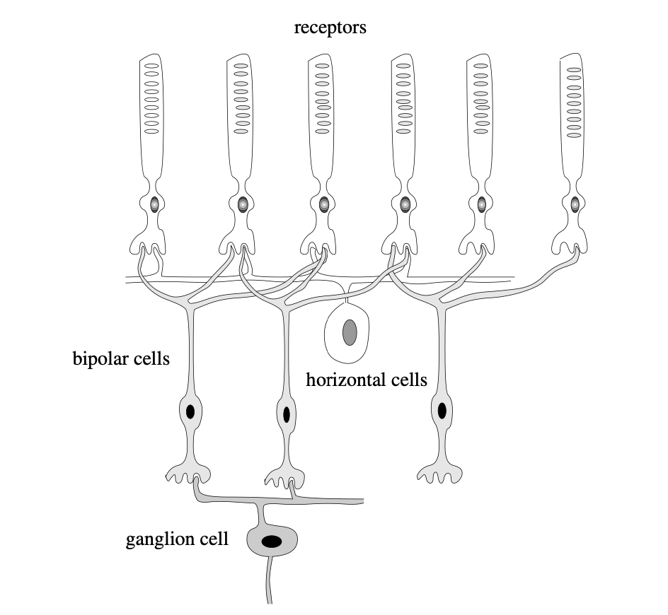
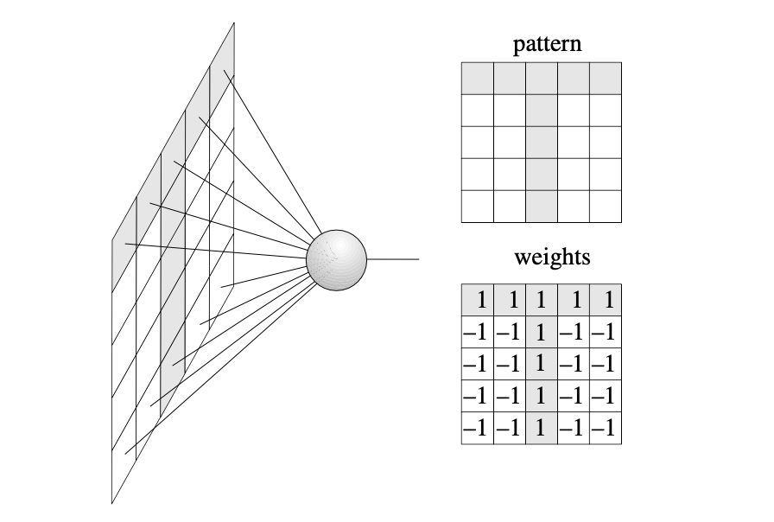
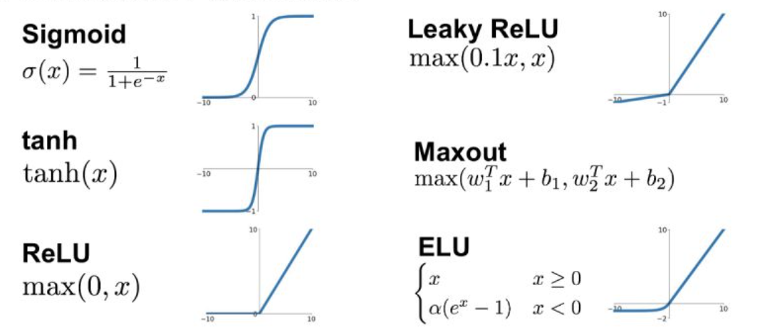
An abstract neuron
Rojas, 1986

Slide 34
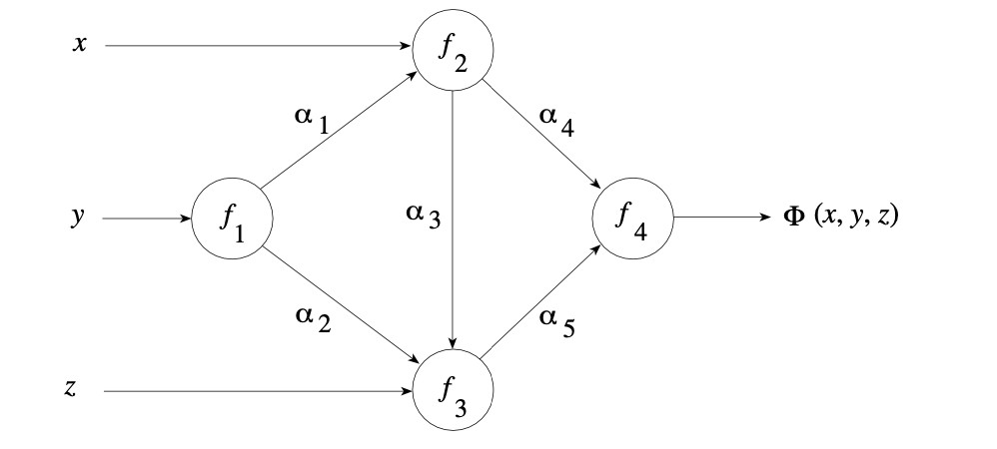
A neural network
Rojas, 1986

Slide 35
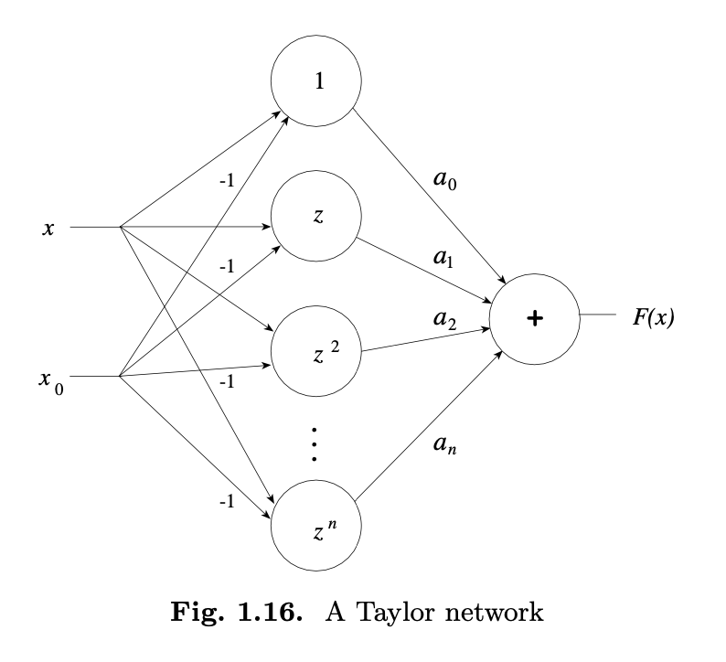
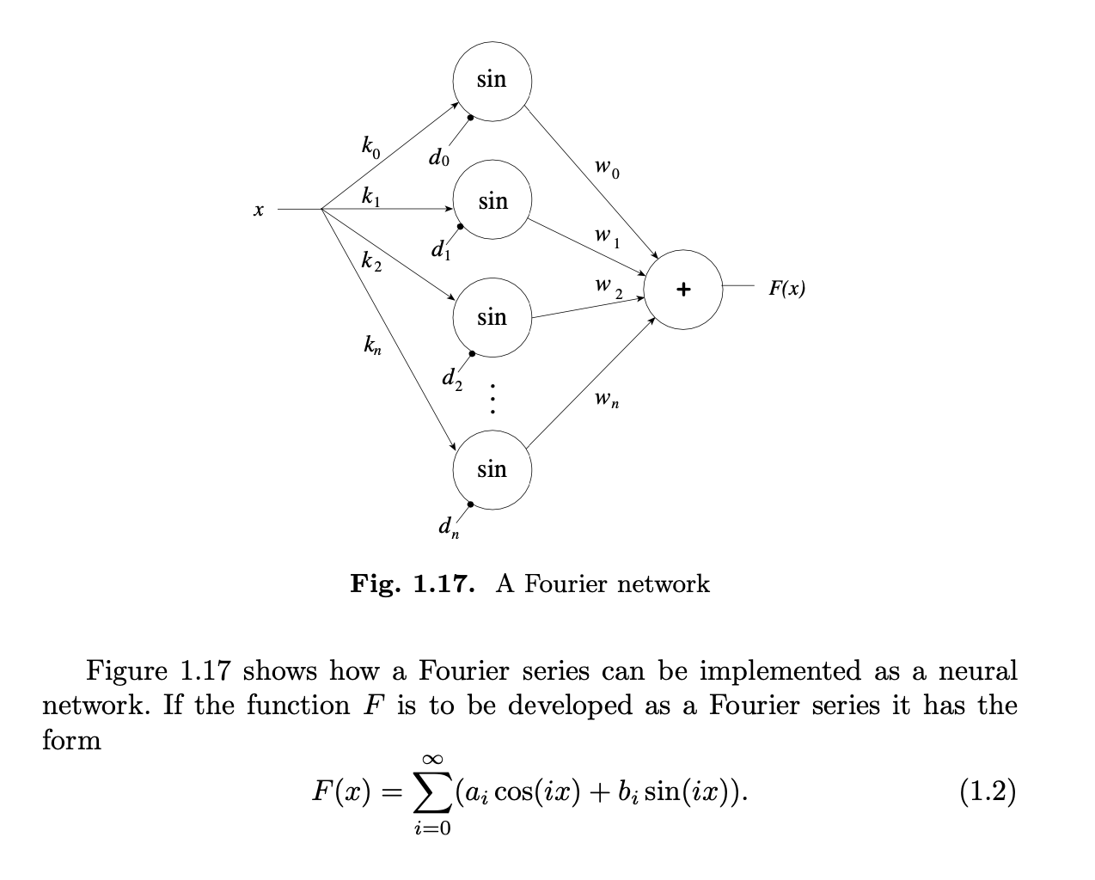
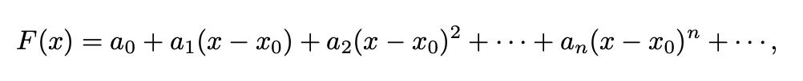
Special types of neural networks
Rojas, 1986

Slide 36
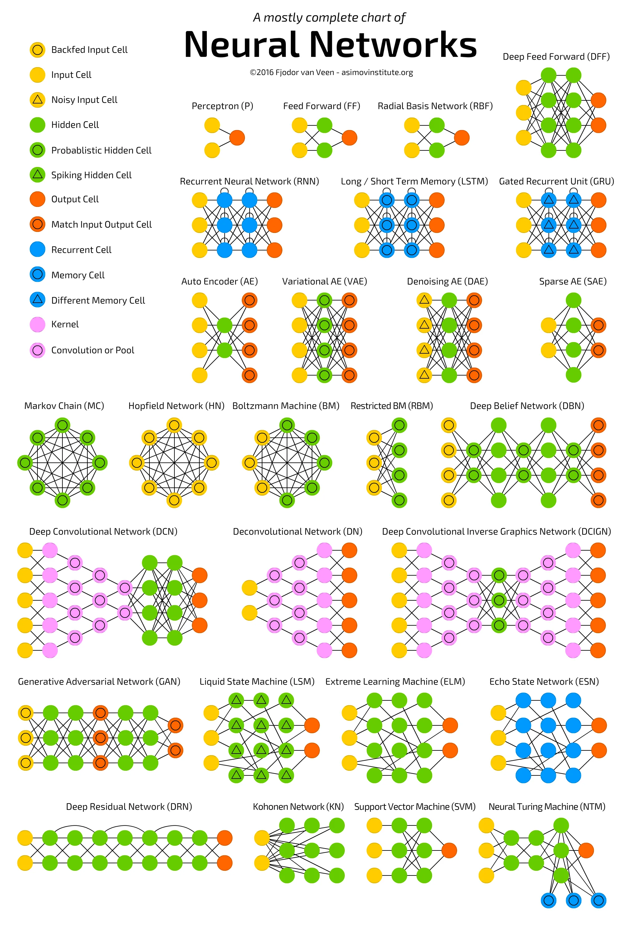
Types of neural networks
(Fjodor van Veen, 2016, asimovinstitute.org)

Slide 37
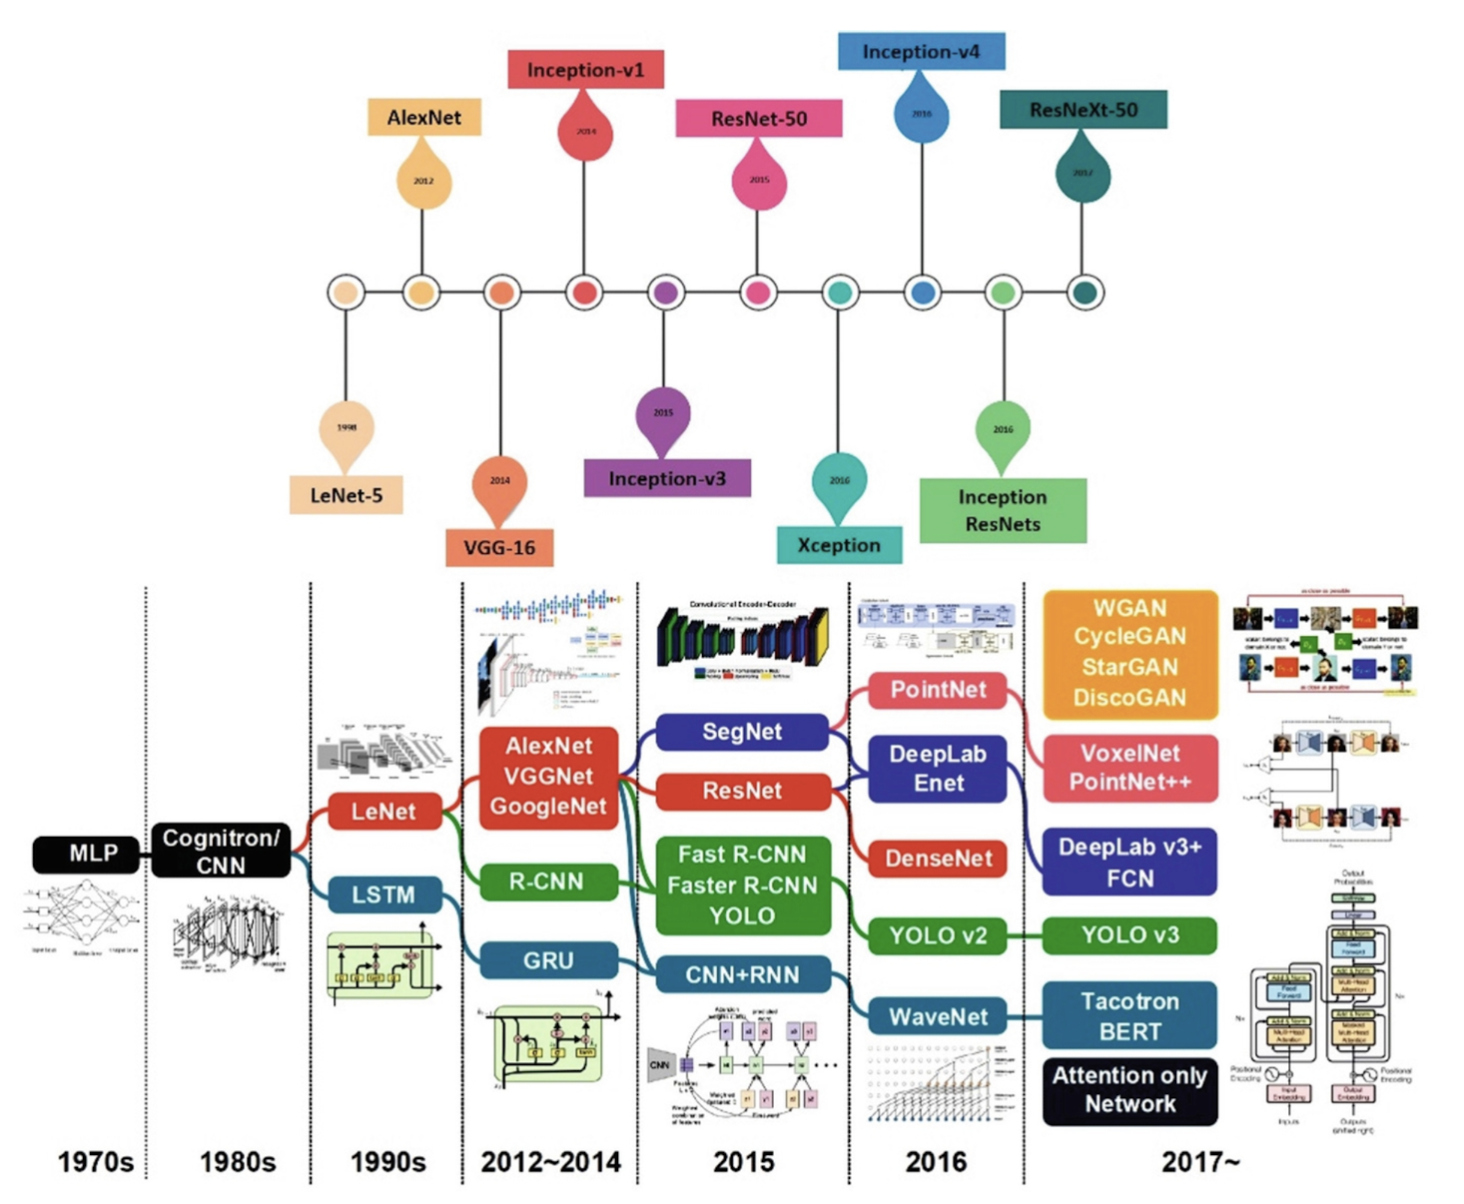

Deep neural networks

Slide 38
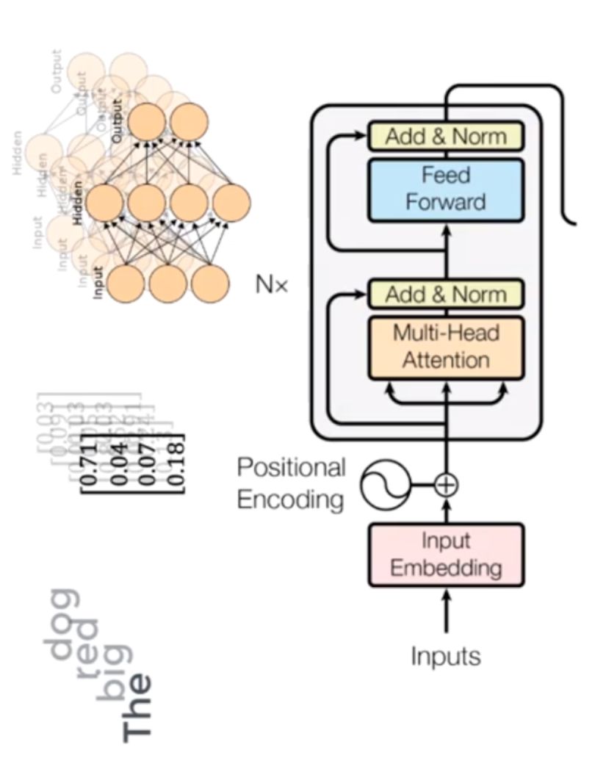
Transformers are deep neural networks
https://builtin.com/artificial-intelligence/transformer-neural-network

Slide 39
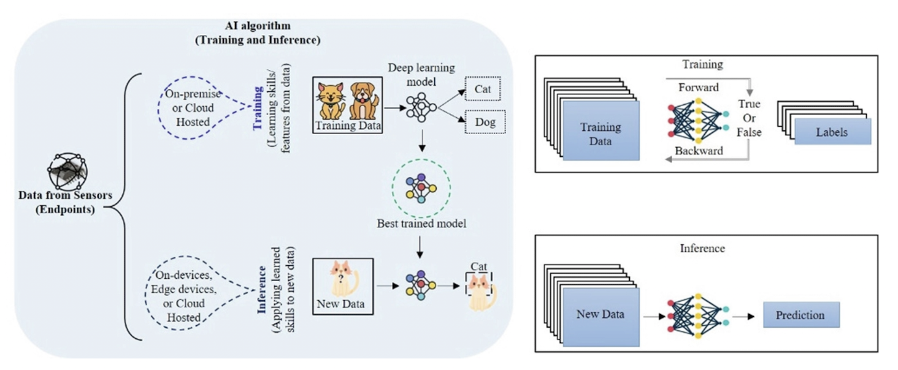
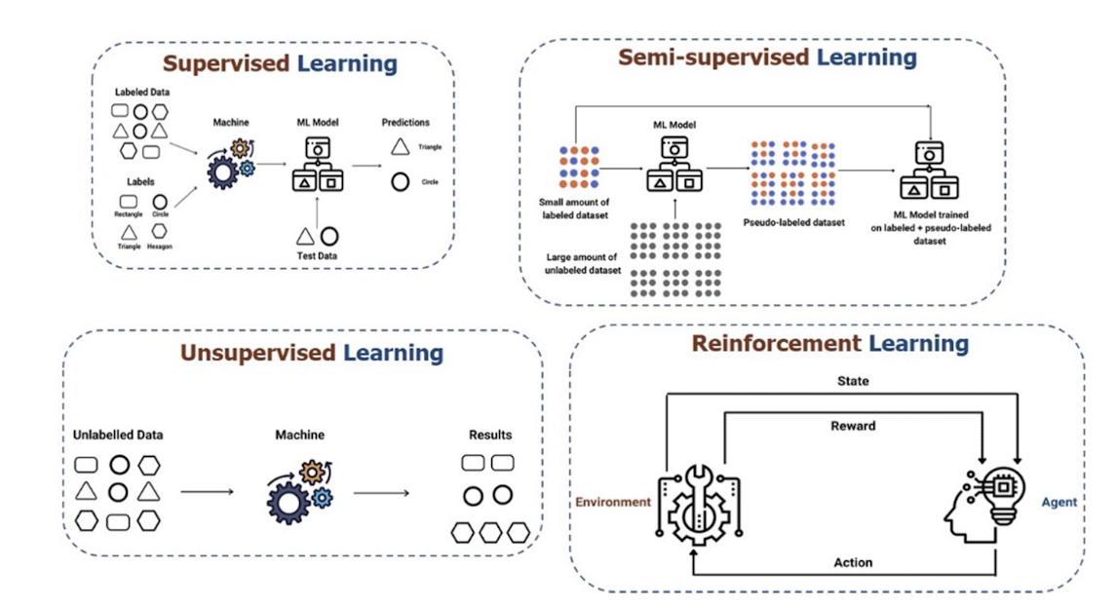
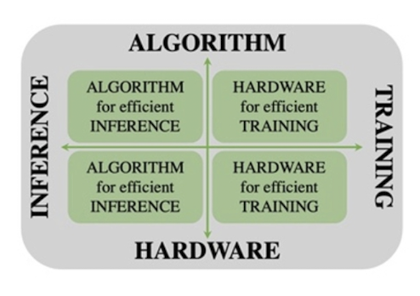
Learning
What is harder? Inference or training?
Mishra et al., 2023

Slide 40
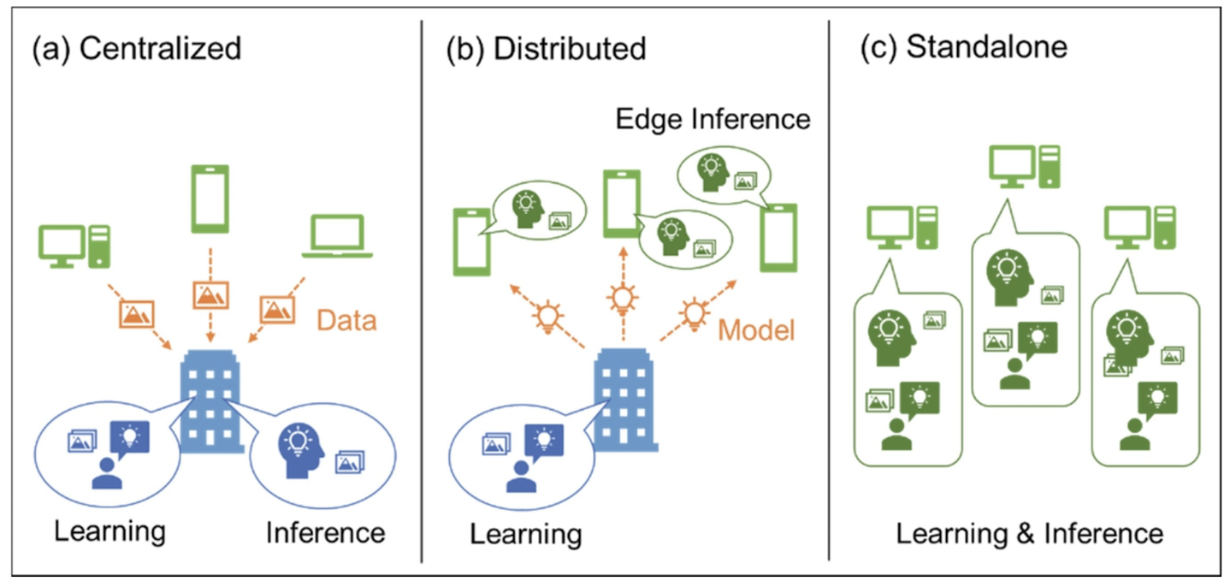
Mishra, Ashutosh; Cha, Jaekwang; Park, Hyunbin; Kim, Shiho. Artificial Intelligence and Hardware Accelerators, 2025

Slide 41
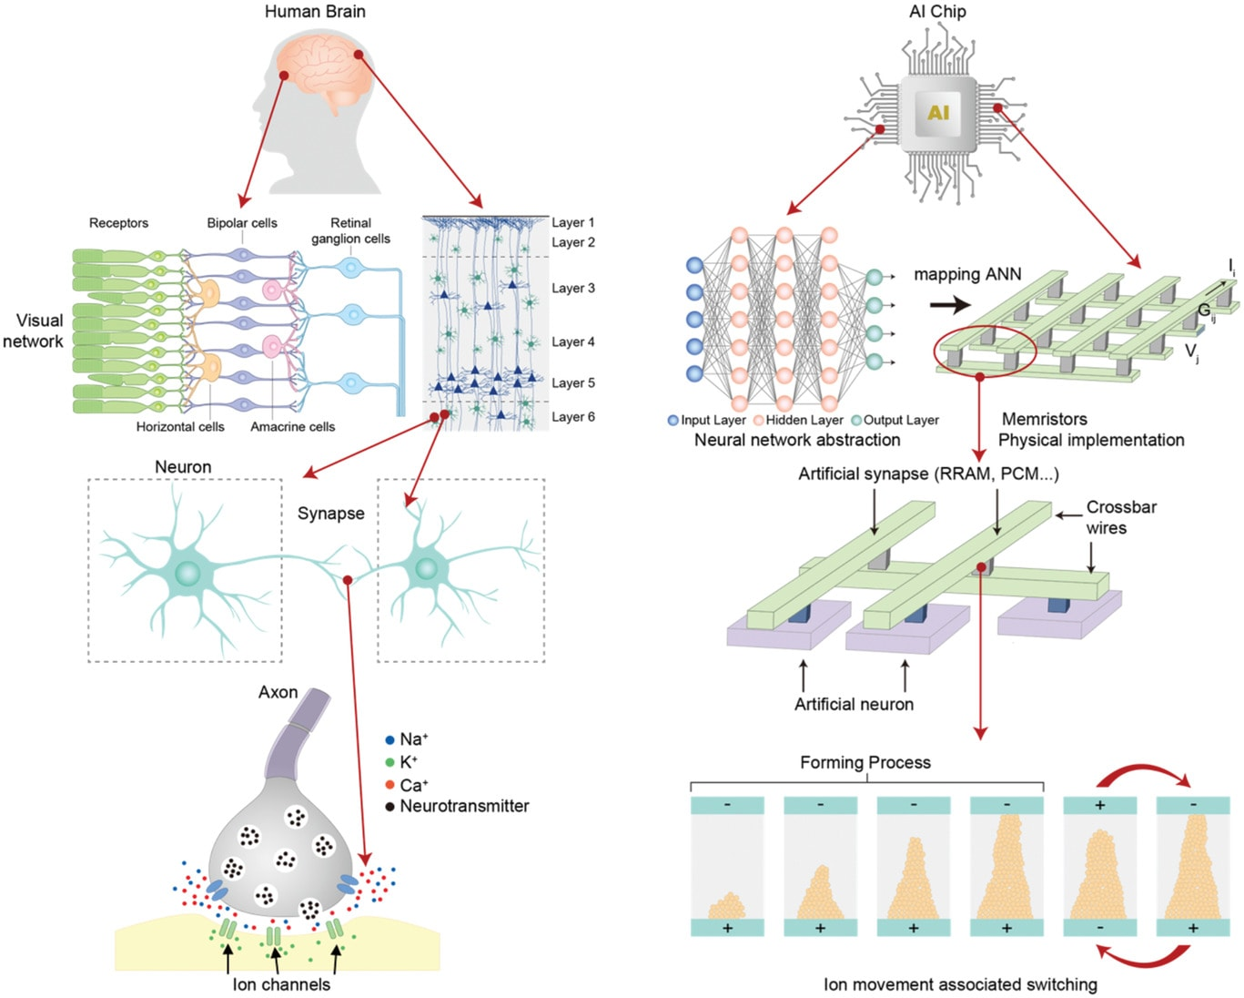
There are two general approaches to developing artificial general intelligence (AGI):
computer-science-oriented and
neuroscience-oriented
Source: “Bridging Biological and Artificial Neural Networks with Emerging Neuromorphic Devices: Fundamentals, Progress, and Challenges”

Slide 42
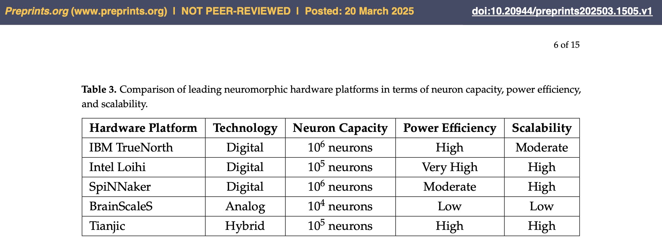
Neuromorphic Computing with Large
Scale Spiking Neural Networks

Slide 43



AlexNet: A classical deep convolutional neural network
AlexNet paper: https://papers.nips.cc/paper_files/paper/2012/file/c399862d3b9d6b76c8436e924a68c45b-Paper.pdf
Liu & Law, Artificial Intelligence Hardware Design, 2021

Slide 44

Deep learning HW issues
FC = fully connected
Liu & Law, Artificial Intelligence Hardware Design, 2021

Slide 45

Exploiting parallelism
Does that come at a cost?

Slide 46
Hardware for AI/ML

Slide 47

General co-processing mechanism
Mishra, Ashutosh; Cha, Jaekwang; Park, Hyunbin; Kim, Shiho. Artificial Intelligence and Hardware Accelerators, 2025

Slide 48

General AI accelerator architecture
GEMM = General Matrix Multiply
Mishra, Ashutosh; Cha, Jaekwang; Park, Hyunbin; Kim, Shiho. Artificial Intelligence and Hardware Accelerators, 2025

Slide 49


Hardware for AI/ML
Metrics
Mishra et al., 2023

Slide 50

Hardware for AI/ML
Mishra et al., 2023

Slide 51



Hardware for AI/ML
Mishra et al., 2023

Slide 52
Hardware for AI/ML
Mishra et al., 2023

Slide 53

Architecture of a TPU accelerator
The main component of TPU is the MXU that consists of 256 by 256 (i.e., 65,536) MACs to perform 8-bit mathematical operations.
The MXU gets its input from the weighted FIFO and unified buffer (UB).
Mishra et al., 2023

Slide 54

Hardware for AI/ML
Mishra et al., 2023

Slide 55

General AI accelerator architectures of FPGA and ASIC
Mishra, Ashutosh; Cha, Jaekwang; Park, Hyunbin; Kim, Shiho. Artificial Intelligence and Hardware Accelerators, 2025

Slide 56


Deep learning frameworks
Deep learning frameworks provide interfaces to implement AI functionalities regardless of hardware or computing platforms.
Most deep learning frameworks also optimize the network in a hardware-friendly manner and utilize the hardware resources and acceleration functions as much as possible.
Because GPUs are commonly used in deep learning, deep learning frameworks widely support constructing and deploying neural networks on GPU and actively reflect the acceleration support from GPU vendors.
In addition, they provide optimizations on standalone accelerators such as TPU and specific environments such as cloud servers.
Mishra, Ashutosh; Cha, Jaekwang; Park, Hyunbin; Kim, Shiho. Artificial Intelligence and Hardware Accelerators, 2025

Slide 57

Food for thought
Why is executing a neural network on a general purpose computer inefficient?
What circuitry/processor would you design to find the shortest path in large graphs?
What if the graph is dense?
What if the graph is sparse?
What circuitry/processor would you design to recognize QR codes for an embedded camera?
Recognition needs to be fast and low-power.

Slide 58



